Slide 1
Network for the Job You REALLY Want!
North canton executive networking group
Dianne Digianantonio
Notes:
Tie back to Dave Tate’s presentation on goal-setting. Figure out where you want to go and have a laser-focus in that direction.
Networking is a skill you need to find AND keep a job.
Not talking today about meeting with lots of people to see what they can do for you.
Intentional work to build mutually beneficial relationships for a lifeline.
Pay it forward.

Slide 2
5 Job-Hunting Tactics
Do some research.
Network, network, network.
Do a skills inventory.
Update your marketing material.
Practice job interviews.
Notes:
Korn Ferry: global organizational consulting firm. Focused on enabling people and organizations to exceed their potential.
More than 75% of people surveyed recently by LinkedIn said they were in their current jobs more for stability than anything else. Meanwhile, 15% said they were waiting for the job market to improve before looking for new work.
Note where Networking fits in the sequence:
1. Do some research about companies and industries you are interested in.
However, it’s up to job seekers to figure out what those firms are doing. List the companies and industries you are interested in, then set up Google alerts on these targeted organizations and industries,. Learn about the challenges and opportunities they currently face. This knowledge will help job seekers develop perspective and become good fodder for questions to ask during networking conversations and even job interviews.
2. Network. Personal meetings, by phone, via Zoom, email, messages, meetings, conferences, social hours
Successful networking is about building relationships, not asking for a new job immediately. Make a list of the possible things you can do for people in your network. Perhaps you can make a connection to an important partner in someone’s field. Or point to a little-noticed but important new research paper. Even small things if done sincerely and genuinely meaningful to the other person can jump-start your networking.
3. Do a skills inventory. The researching and networking steps give job seekers an idea of what skills they’ll need to land a new role. If you already have those skills, make sure that any certifications are up to date,.
4. Update your marketing material – resume, LinkedIn site.
5. Practice job interviews.
Video interviews were already gaining traction among many recruiters because they can eliminate the expense of bringing candidates to the office. One 2019 survey indicated that 47% of big employers already used video interviewing for some roles, and experts agree that video calls will only increase after the pandemic.
Candidates can practice doing a video interview with a friend. Video conferencing software from Zoom and other providers is free, in one form or another; friends can judge one another on how each look and sound.

Slide 3
Notes:
Two fabulous books for job search.
1, Highly recommended by Pat Fladong. Fast read and browsable to find what you need
2. Networking book – also a quick read with great suggestions

Slide 4
How are YOU Spending Your Time?

Slide 5
CHAT
HOW MANY HOURS DID YOU NETWORK LAST WEEK?
Notes:
Be honest. How many hours did you spend networking last week? Include time on the phone, online, face-to-face.

Slide 6
Networking? I’m too busy . . .
Learn something useful
FOCUS YOUR JOB SEARCH
GET RESULTS FASTER
Notes:
You’ve probably heard about the benefits of networking and know you probably should do it, but it can be hard to get started.
Is networking really worth the effort?
Here are some advantages for job-seekers:
Learn something useful in your industry. Who is doing what? Innovations? Trends? You might have missed a lot while doing your former job.
Focus on companies or industries that offer super opportunities and interest you. You might be surprised.
Stop competing for only the published jobs; Learn about new jobs before everyone else.

Slide 7
NCENG Pyramid Of Success
Job
Interview
Value & Marketing
Networking & Discovery
Time Investment

Slide 8
NCENG Pyramid Of Success
Interview
Value & Marketing
Networking & Discovery
Job
Job-Seeker Groups
Job Agents/Recruiters
Activity Tracking Software / Weekly
Marketing Activity Planner
Researching
Ideal Employers
Ideal Role / Position
Ideal Geography
Job Boards
Networking Events / Opportunities

Slide 9
Applied anywhere
Real Estate bill
NCENG
Hair Salon
Interviews
Surprise!
Notes:
One November, IT assistant manager was laid off. Devastated, discouraged and hurt. Prayed, walked and started cleaning closets.
January, Pat Fladung called him and invited him to NCENG. Came to several meetings.
Looked online, applied everywhere: Best Buy, Home Depot, LinkedIn
Real estate bill; How pay? Looked online for comparisons. Saw job post for assistant IT director for Stark County Auditor’s office. Applied.
No response. Wife at hair salon. Hair dresses said her nephew is auditor. Immediate text.
Interviews (during mother’in’laws calling hours, etc) Wait.
Interviewing as freight specialist for Home Depot, Auditor’s office called. Auditor said he checked with a friend on the board of his previous company. He put in a good word
Started new job March 25.

Slide 10
Where is Your Next Job?
70% of Jobs Are Hidden

Slide 11
Networking Opens Doors to ‘Hidden’ Jobs
Harvard Business School
65% - 85% of jobs are found through networking
LinkedIn
70% - 80% of new jobs were obtained through networking
Recruiting Blogs
80% of today’s jobs are landed through networking
U.S. Bureau of Labor Statistics
70% of jobs are found through networking

Slide 12
CHAT
What percentage of your job search time should you spend networking?
Notes:
Be honest. How many hours did you spend networking last week? Include time on the phone, online, face-to-face.
What percent of your job search time
should you spend networking?

Slide 13
Notes:
Making one connection can lead to many more through referrals, word of mouth and redirection of your job search.

Slide 14
tagcrowd.com
Notes:
Interaction with other people to exchange information and develop contacts, especially to further one's career.
The exchange of information or services among individuals, groups, or institutions; specifically, the cultivation of productive relationships for employment or business.
When you combine these attributes, you will have uncovered the secret of powerful connections that lead to RICH relationships.

Slide 15
How Many People Do You Know?
Wall Street Journal says:
472

Slide 16
Why Does That Matter to Your Job Search?
The Strength of Weak Ties
“Your casual connections and acquaintances are more helpful when it comes to job hunting than close friendships.” S
Sociologist Mark Granovetter
People You May Know
People who connect to others with only peripheral connections find those people are more helpful in finding your new job.
LinkedIn 5-year experiment

Slide 17
Networking is a
life-long skill.
It is the cultivation of productive relationships for employment or business.
At its best, networking is the exchange of information or services among individuals, groups or institutions.
Look for opportunities to help other people achieve their dreams.

Slide 18
A Advice
I Information
R Referrals
Notes:
HOW CAN YOU INITIATE NETWORKING?
BIGGER THAN SIMPLY LOOKING FOR A JOB!
Build long-term, mutually beneficial relationships.
Ask for advice:
How did you choose to work with your current employer?
What skills are needed to move ahead in (your profession)?
Where are you seeing the most opportunities in this industry?
What is one problem within your department/company/field that if solved would make your life a lot easier?
Ask for information:
How are people recognized for their work here?
What is a typical career path in your company?
How would you describe the organizational culture?
Ask for referrals:
Can you think of other companies I should contact during my search?
Is there anyone else you think I should talk to as I continue to gather information?
Who are the influencers in (your profession)?
Who else might be able to help me in my career development?
Ask: What can I do to help YOU?

Slide 19
R Research
R Reciprocate
R Relationship building
Notes:
BIGGER THAN SIMPLY LOOKING FOR A JOB!
Build long-term, mutually beneficial relationships
Research:
Prepare yourself for informational interviews by researching your contact on LinkedIn, Google search and mutual friends.
Learn about where they have lived, their educational background, where they have worked, responsibilities they have had.
See if you have any mutual friends/history.
Reciprocate:
It’s about giving, not receiving.
Offer to provide information and connections to your contact.
Forward relevant news items, industry changes, personnel updates and more to your contacts.
Ask what you can do for him/her.
Relationship building:
Ask if you can keep in touch. If so, ask how the person likes to receive updates: phone calls, emails, texts, Messenger, postal mail
Deduce during the conversation what that person in particularly interested in. If unsure, ask.
Offer to be a resource to that person and his/her friends.

Slide 20
Discussion: DESCRIBE A TIME YOU ASKED FOR Help with your JOB SEARCH. WhAT WAS THE RESULT?

Slide 21
How to Network for Career Success
Find the Right Person
Connect
Build a Relationship
Follow-Up
Notes:
Networking is NOT about finding people to do your bidding in the job search!
Networking is building your circle of influence – friends, coworkers, clubs, business associates, neighbors. We network to benefit other people and try to solve their problems, even a little.
People you rely on for information and support. They rely on you for ideas and strength. You encourage each other.
Sometimes you outgrow each other or move on. Sometimes good things happen to keep you together. Sometimes bad things happen that make networks grow apart.
But, while they are present, networks play a powerful role in your life.

Slide 22
Research person.
Find shared interest.
State purpose.
Ask 3-4 questions.
Exchange information.
Agree on follow-up.
Do NOT ask for a job.
Best Practices:
Informational Interviews

Slide 23
Quality or Quantity?
Be selective about the jobs you pursue.
Stay organized.
Notes:
Here’s the takeaway: The right number of jobs to apply for is going to be different for each person. Instead of focusing on the quantity of applications you submit, put your energy into screening each job carefully so you can craft high quality applications.
Invest 10 hours researching each company where you want to work. – From Pat Fladong of NCENG.
Keep good records to avoid awkward moments when you forget something important.

Slide 24
Find
Connect
Relate
Follow-Up
Leads/Referrals
Friends
Family
Notes:
1st degree connections represent only a small portion of opportunities your network holds
2nd degree connections are exponentially larger than your current professional network.

Slide 25
What have I done for these people lately?
Industry
Profession
Groups
Government
Volunteers
Friends
Notes:
WITH WHOM SHOULD YOU NETWORK?
Powerful connections are people who can make things happen, and make things happen for you.
Pause for 2 minutes . . . .
Exercise: List your connections in
Government
Your industry (healthcare, education, manufacturing, retail)
Your profession (HR, IT, sales, communications, product management, engineering)
General business (chamber of commerce)
Professional associations
Volunteer organizations

Slide 26
Find
Connect
Relate
Follow-Up
Be generous.
Find a way to help that person.
Be intriguing.
Think people, not positions.
Excerpted from Power Relationships by Andrew Sobel
Notes:
Be generous. Give before you ask. Comment on people’s status.
You may have something even those you see as wealthy/successful may need.
Be intriguing. Don’t be needy
Successful executives identified 25-30 relationships that made all the difference to their careers.
Critical few. Follow up 2-3 times a year.
Next tier of 50-100 contacts who have helped you or have the potential.

Slide 27
Universal Truth of Connecting
The question is not . . . “Whom do you know?”
The REAL question is . . . “Who knows YOU?”
Notes:
Who is in your circle of influence? Within that group, are you a leader or a participant?
Goal is to build your circle of influence and help each other.
Old saying: “You get what you want by helping others get what they want.” Still true.
To climb the ladder of success, you don’t need more techniques and strategies, you need more friends.
Exercise: List the knowledgeable and connected people you know who are willing to help you.

Slide 28
Where can you connect?
Professional associations
Business groups
Conferences
Online communities
Job fairs
Parties
Grocery store
Notes:
Professional associations –Volunteer for boards or committees
Business groups – Be selective, but get involved
Conferences – Offer to present or join a panel
Online communities – Be visible
Job fairs – Prepare. Know who will be there. Prioritize.
Parties – Stay alert. Ask for introductions.
Grocery store – Always be prepared!

Slide 29
Watch Body Language
Eyes: The bulk of what we need to know about how someone is feeling comes from their eyes.
Body Language: Arms or legs crossed can communicate resistance.
Tone of Voice: We can miss meta-communication via facial expression due to wearing masks. Tone of voice becomes more important.
Notes:
“We roll our eyes to show contempt. We narrow them to show suspicion and widen them to show concern. Sure, we’re losing some information by not being able to see people’s full faces, but the bulk of what we need to know about how someone is feeling comes from their eyes.”
For example, if an individual is sitting with their arms or legs crossed, this can communicate a resistance to being open to what is being said. If a person uses their hands excessively through conversation, they may be experiencing feelings of anxiety.
We can miss meta-communication via facial expression due to wearing masks. Tone of voice becomes more important. So does body language.

Slide 30
what are best practices for connecting?

Slide 31
The Ask: Easier Than You Think!
People you know
People you don’t know
Hi (Joe). I’m calling to ask for a little advice . . . I’m in the job market and looking to build my network. Could I have maybe 15-20 minutes with you to help gather info about the job market that will help me move forward with my job search?
Hello (Allison). My name is ______. Our mutual friend _____ recommended I talk with you as someone who might be willing to share some of your insights and experience with me on my job search.

Slide 32
Notes:
Referred applicants are 5 times more likely than average to be hired
AND 15 times more likely to be hired than applicants from a job board
Use your connections to reach 2nd and 3rd levels
Don’t depend only on the “jobs” feature on LinkedIn
Do ask for an introduction
Research, research, research
Don’t engage at an inappropriate level
Be direct and respectful of their time
Introduction – personal, relevant. Genuine, upfront. Don’t hound.
Legitimate reason to comment on a post
Jobvite: Used by LinkedIn to hire
Funnel from current website: visitors/applications/interviews/offers/hires
LinkedIn, Jobvite, Ladders, The Wall Street Journal, FlexJobs.com and Job-Hunt.org have real-time lists of employers who are hiring. -- Find other smaller employers who do similar things and develop your own list of target employers.

Slide 33
Long-lost friend calls
Offer to provide intro
Reach out to former colleague
Not sure I can help
Notes:
(Friend 1) Hi Dianne!!! NAME here! Great to connect with you, so much time has passed since our days together at COMPANY. I live in St. Petersburg Florida now, and kids are all grown and graduated from college. I would love to set up a networking call with you and catch up! I got laid off from COMPANY recently and would love to connect. Do you have some time for a call this week? Just let me know what time is good for you. Best, NAME, PHONE NUMBER
(Dianne) GREAT. This week, Tuesday and Friday afternoons are best for a phone call.
(Dianne) The reason I'm writing is to introduce you to a FRIEND, who now lives in St. Petersburg. She would like to join NAME in a sales or fundraising role. Would you please forward her resume to the appropriate person?
(Friend 2) We have a list of job openings at WEBSITE. The best thing to do is to see if there is anything of interest here and then I can put in an internal reference to HR.

Slide 34
Find
Connect
Relate
Follow-Up
Use LinkedIn
Follow key players at companies where you want to work
Make list of desired companies
Connect with people on your level
When you visit their profiles, show your profile
Like or comment on their posts
Wait to see if they reach out to you first
Ask to connect with them using a personalized message NOT the default
Notes:
Relate:
100% complete profiles – 40x more opportunities
Join groups
Comment on friends’ status
Forward job listings
Update your status often

Slide 35
For Remote Jobs, Show You’re Tech Savvy
Add remote-friendly keywords to your resume, cover letter and
LinkedIn profile.
Describe how you worked remotely with customers and other employees.
Monitor and participate in social media for jobs.
Notes:
In a recent Jobvite survey, 58% of recruiters said they use social media like LinkedIn, Facebook and Instagram to promote their brands and connect to talent.
Jobvite CEO says, “Maintain a clean and active digital identity, build strong professional network connections and get familiar with the employer’s brand.”
Mention specific video technologies you’ve used, such as Zoom, Google Meet, Microsoft Team, GoToWebinar, Cisco WebEx and more.
Cite Google Docs or other document-sharing services..

Slide 36
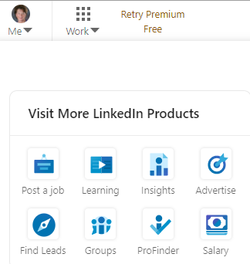
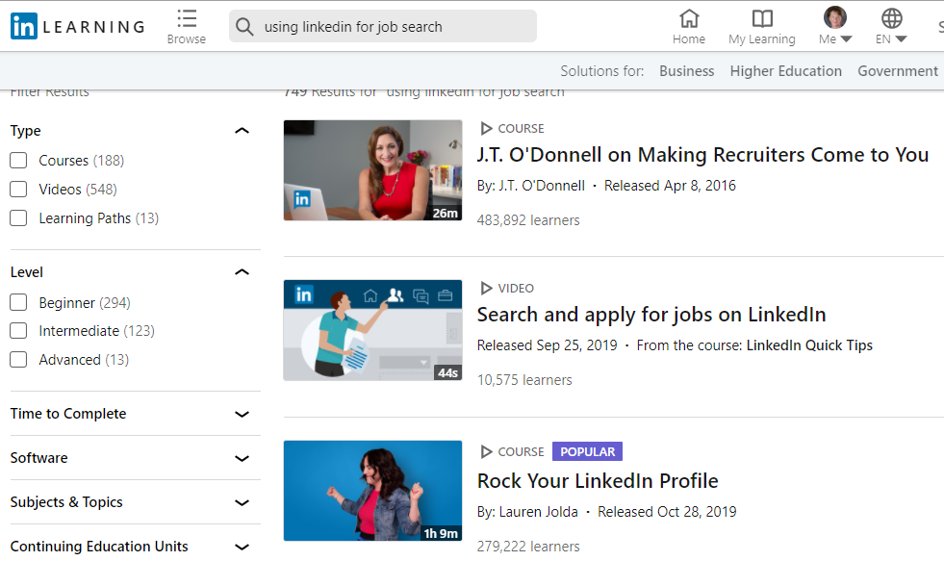

Slide 37
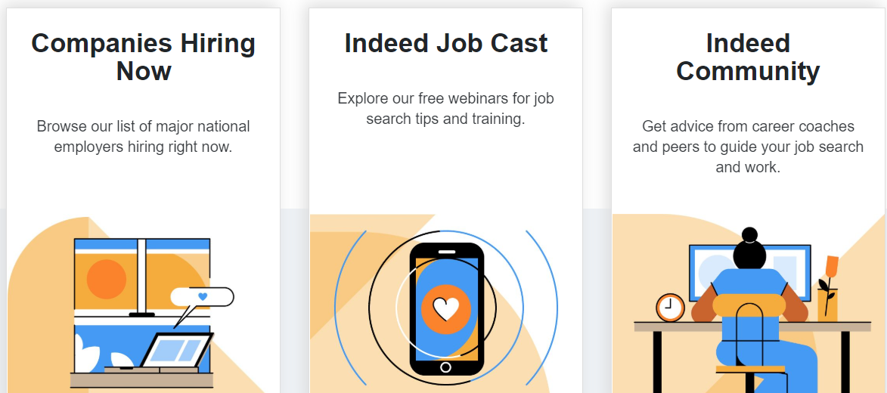

Slide 38
Discussion: what can you do to find ‘hidden jobs’ and make connections?
Report out: Share
2-3 actions with everyone

Slide 39
Be Persistent – and Clever
It takes an average of 8 touches to get an initial meeting with a new prospect.

Slide 40
Create your Elevator Speech
Objective: Describe yourself quickly and make yourself memorable.
What value do you provide?
How do you provide this value?
What is unique about your offer?
Call to action.
Notes:
PRACTICE AT TABLES
The pitch isn’t your autobiography or a detailed business plan, it’s an overview of who you are, what you do and how you can help the listener. It’s you selling yourself in a brief and concise manner, using a format that most people are familiar with. Whilst the elevator pitch is similar to your personal brand statement and bio, it’s delivered verbally and thus should have a slightly different wording to be punchy and memorable.
Use at industry conference, a networking event, a seminar or just taking the elevator at your hotel – there are always opportunities to strike up business relationships.

Slide 41
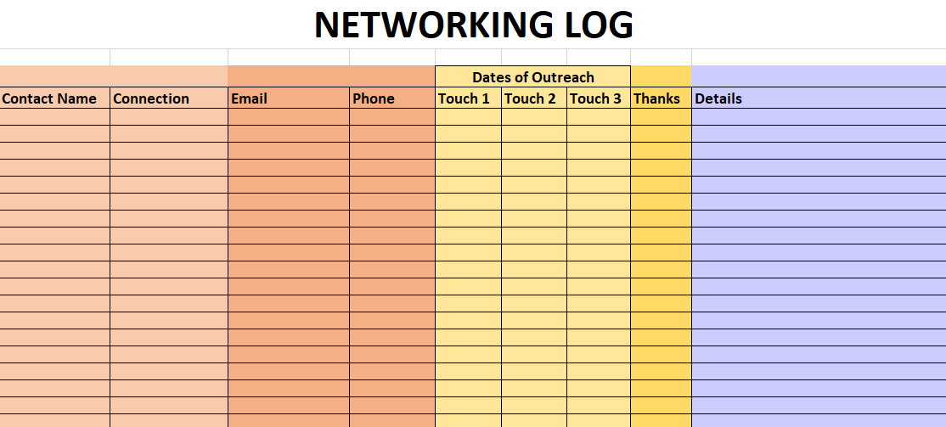
Notes:
42% more likely to achieve your goals and dreams, simply by writing them down on a regular basis.
Timeline:
Weekly to-do list: How many contacts to make? Number of informational interviews? NCENG recommends identifying 3 new companies each week and contacting 3 employees at each company.
Daily schedule: Budget time for your job search (networking, applying for jobs, following up), physical activity; family; personal interests. NCENG recommends spending 80% of your job search time networking because 80% of jobs are found through networking.
Set milestones to accomplish every 2 weeks of month to help you stay on track.

Slide 42
Find
Connect
Relate
Follow-Up
Send 2 Thank You Notes
Stay Connected?
Preferred communications channel?
How can you reciprocate?
Notes:
Does your contact want to stay connected?
What is that person’s preferred communications channel?
Text
Email
LinkedIn
Periodic updates on your job-search process (very effective)
Ask how you can reciprocate
Perhaps you can refer someone with a particular skill set as you network widely
Send 2 Thank you Notes:
1 electronic and 1 handwritten

Slide 43
CHAT
What motivates you to network?
Notes:
What are the top 2 motivators for you to network?
Build relationships
Get inside scoop on new job opportunities
Learn about a company’s culture
Get referrals
Seek advice
Find “hidden” jobs
Stay busy
Help someone else
Other

Slide 44
Thank you!
Notes:
Learn to love networking.
Stay healthy and productive.
Set goals and celebrate your successes.
Make new friends.

