Slide 1
SPECIAL SITUATION INTERVIEWS
Evelyn P. Hronec
CPA, MSA
Certified Personnel Consultant
Managing Director

Slide 2
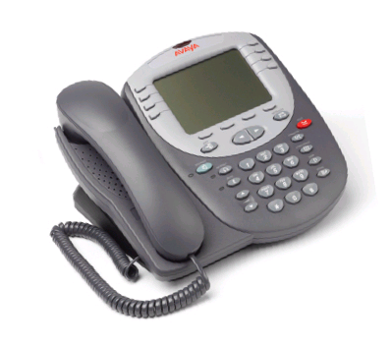
Special Situation Interviews:
Phone Interviews
Video Interviews
Panel Interviews
Notes:
Can you please change Skype to Video (change picture as well

Slide 3
Phone Interviews
Often used as the 1st step in the interview process
Very hard to prepare for
Your goal during the phone interview is to get a face-to-face interview!

Slide 4
Phone Interviews
Challenges:
The only communication is verbal
You will need to show your enthusiasm and sell yourself through the tone and inflection in your voice
Notes:
This is the first time I’m noticing the line going through our loge. Can you please fix?

Slide 5
Video Interviews
Two Types:
Two way exchange (Skype/FaceTime/Google Hangout)
One-way, prerecorded interviews (Asynchronous interviews) Candidate records and answers pre-set questions from a link. No interaction involved.
Notes:
Add some graphics…maybe a computer and/or a phone. Can we jazz this up a bit? You can change the wording around if you need to

Slide 6
Video Interviews
Saves time and money
Good for hiring for remote locations or for multiple reviewers
Needs extra preparation
Your goal during the Video interview is to get an invitation into the office!
Notes:
Replace the word Skype with Video

Slide 7
Video Interviews
Challenges:
Reliance on technology
Bad connections/Poor video or audio quality
Failure to get call through or problems with the link
Fear of looking computer illiterate
We typically look better in person than on video
Notes:
Get rid of line through logo

Slide 8
Panel Interviews
Used to save time and when a position interacts with multiple departments.
Can be very nerve wracking
Your goal is to knock it out of the park with everyone!

Slide 9
Panel Interviews
Challenges:
Fielding questions from people with different agendas
Trying to establish rapport with multiple people at once
More things for you to remember
Notes:
Fix line please

Slide 10
Regardless of the interview type, you need to think clearly when the company representative calls so you can set yourself up for success.

Slide 11
Phone Interview Skills

Slide 12
Setting up the Phone Interview
Know with whom you will be interviewing. An interview with HR will be different than an interview with the Hiring Manager.
The key is to get as much information as you can about the interview up front so you can prepare.
Clarify that you will be phone screening for the same position you applied for.
Ask if they have a job description for the position that they can send you before the phone interview.

Slide 13
Prepare for the Interview
Try to find your interviewer and/or hiring manager on LinkedIn. Maybe you two share some commonalities
Review the job description and list examples of how you’ve performed each required skill set
Have specific examples of results and accomplishments handy
Notes:
Correct the line please

Slide 14
Before the Interview
Make sure you are somewhere where you are undisturbed
Leave your cell phone where it won’t distract
you
Dress for the interview

Slide 15
Before the Interview
Have in front of you:
Your resume
The job description
Your list of accomplishments
A list of references
Have handy:
A glass of water
Pen and paper
A calendar to schedule the face to face

Slide 16
How do You Make a Good Impression?
Sit up or stand up so your voice projects
Put a smile on your face
Speak confidently
Don’t interrupt
Listening skills are especially important here
Say “Yes” or “ I see” periodically so they know you are following their conversation.
Avoid using “um” or “uhs”

Slide 17
As in the face to face interview, the first five minutes of the phone interview are the most important. They will dictate the subsequent line of questioning.
So….try to build rapport immediately!
Notes:
Fix the line please

Slide 18
Building Rapport
Thank them for their interest in you as a candidate
If you found the interviewer on LinkedIn and have some commonalities, make a comment about it
If you found something interesting or a good article on the company through your research, make a comment
Try using Tonal Parity…
A technique where you match the interviewer’s rate of speech, volume and tone

Slide 19
The Close
The Close
The worst thing you can do is hang up the phone and have no idea what your status is.

Slide 20
Steps to Close the Interview
Reiterate your interest and excitement about the position
Indicate that, based on what you’ve learned about the position, you would be anxious to meet face to face to discuss the position in further detail
Ask when they will be scheduling in person interviews

Slide 21
Steps to Close the Interview
Reiterate your interest and excitement about the position
Look at your calendar and indicate when you would be able to meet during that time period and can you set something up now?
If they stall on setting up an interview, ask when you can expect to hear from them again

Slide 22
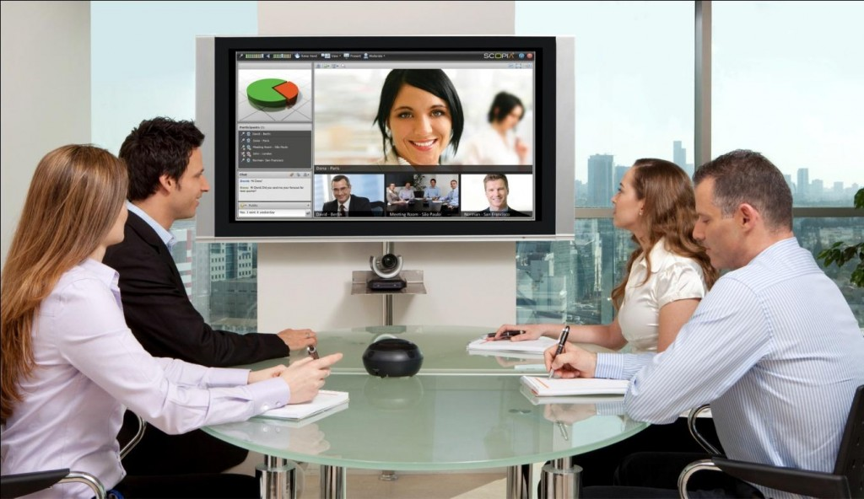
Video Interviewing
Trends show increasing use of video interviewing in multiple forms
Notes:
Make more interesting please

Slide 23
interviewing skills for

Slide 24
Skype Tips
Make sure your technology works
Understand how Skype works
Download the latest version for maximum performance
Make sure your microphone works
Use the “Skype test call” function
Make sure your internet connection can handle a video call
Troubleshoot at support.skype.com

Slide 25
Stage Your Background
Get the lighting right
Natural light is best or a lamp aimed straight at your face from behind the camera
Clear away clutter
Close doors and windows
Make sure everyone in your house knows you’re in an interview

Slide 26
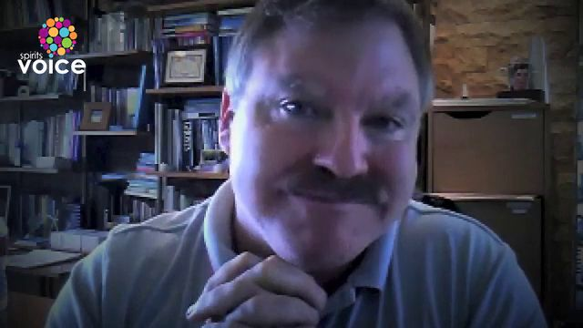
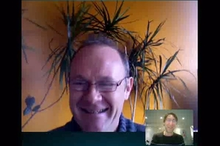
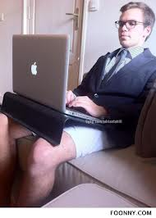
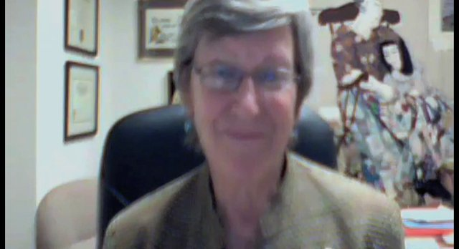
What NOT to do!

Slide 27
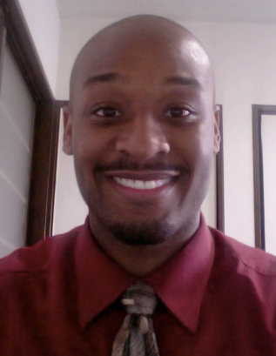
How You Come Across
Sit up Straight
Get your upper body in the camera’s visible area, not just your face
Keep your hands still
Look straight into the camera lens. That’s the only way you will appear to be looking directly at the interviewer
May be best to raise your laptop so the camera is at eye level

Slide 28
What to Wear
Avoid stripes or patterns
Darker is better
Wear something that will stand out from your background
Always best to dress one step up from company’s attire

Slide 29
Other Tips
Close any programs on your computer that make a noise
Have your phone handy in case of technical difficulties but keep it on silent
Keep ashtrays, cigarettes, wine glasses, etc. out of sight
Keep your skype username and picture professional

Slide 30
Expect Technology Problems
Plug into an Ethernet cable if possible
Have an extra computer handy
Make sure you have phone numbers written down
Keep your computer plugged in

Slide 31
Practice, Practice, Practice
Grab a friend and practice making calls
Practice your opening line
Make sure you know who’s making the call – you or prospective employer?
Make sure you’re straight on time zones
Make sure everything looks good

Slide 32
Asynchronous Interviews
This Photo by Unknown Author is licensed under CC BY-NC-SA
Notes:
That’s a cute picture but Asynchronous means one-way, not two-way, so picture doesn’t really match

Slide 33
Things To Remember
Can record on your own time
This makes it more convenient
Can rerecord several times
Gives you an opportunity to get it right
Interviewer has a permanent record of the interview
Will be seen over and over again
Notes:
Replace with “Things to Remember” and change picture or whole slide. Not sure I like this picture here and deleted last two points

Slide 34
Skills for Panel Interviews

Slide 35
Why Companies Use Them
It’s an easy way for several people to get to know you quickly
Helpful when a company needs to get hiring consensus from multiple people
Demonstrates how you interact, and can potentially work with, different departments in the organization

Slide 36
Panel Interview Tips
Names
Learn and remember the names of interviewers and their role in the organization
Try to get this information ahead of time. Look them up!
Take a notepad to help with memory
Shake hands with each person and repeat their name

Slide 37
Panel Interview Tips
Always bring several copies of your resume
Address everyone when answering a question
Whoever asks the question, face them to initially answer and then turn to the others to complete the answer.
Try to show how your answer affects the other departments in attendance
Understand what each person’s position is in the company and address them when speaking in their area of expertise
Notes:
Need double quote marks in front of quote

Slide 38
Panel Interview Tips
Don’t focus only on the decision makers and ignore lower level or more silent panel members.
Because they are a part of the process, they have the ability to reject you.
Notes:
Can you make it so the red x doesn’t hide the words. An you put “reject you” on a separate line?

Slide 39
Panel Interview Tips
Project self-confidence!
This is a great opportunity to learn about the company’s culture and dynamics within the organization.
This is a conversation, not a grilling! Have fun and make yourself likeable.

Slide 40
Wrapping Up
At the end of the interview, shake everyone’s hand whether they asked a question or not. Indicate that your contact information is on your resume and they are free to contact you with any additional questions.
Send a Thank You to everyone and make it slightly different for each person. They might share.

Slide 41
Regardless of the type of interview, interest in, or suitability for the position, send a Thank-You email.
Notes:
Can we find an email Thank you instead of typewriter?

Slide 42
Questions?
Notes:
Change the skype to video. Maybe a computer or phone would be better…

Slide 43
www.CFStaffing.com

Slide 44
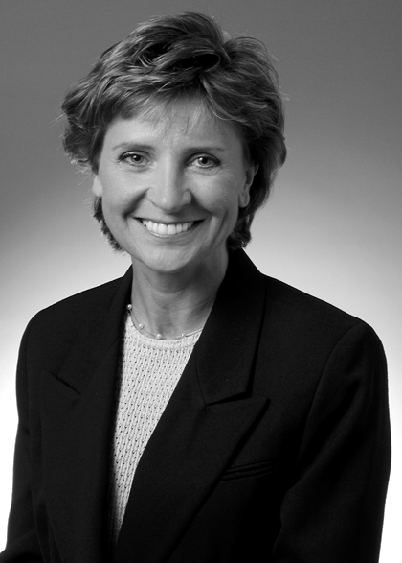
Creative Financial Staffing
Evelyn P. Hronec
CPA, MSA
Certified Personnel Consultant
Managing Director
Evelyn Hronec opened the CFS of Northeastern Ohio, Ltd. office in 1996 after working as a CPA for BrunerCox (now CLA). She has more than 16 years of internal auditing experience in the financial services industry, holding various managerial positions including Director of Internal Audit. Evelyn holds a BSBA degree in Finance from The Pennsylvania State University, and a Masters of Accountancy from The University of Houston. She also holds the Certified Personnel Consultant designation.
Evelyn is a member of the Ohio Society of CPAs, the Institute of Management Accountants and the Ohio Recruiters Association. She is an Advisory Board member for the Stark State Business College and a Board Member of the Canton chapter of the Institute of Management Accountants.
Evelyn speaks to various audiences on hiring, employee relations and career issues.

