Slide 1
Get Carded
and Save @
Notes:
I’d like to thank each of you for inviting me to join you today. Talking about the library is one of my favorite things to do so I am excited to be here.
September was National Library Card Sign-Up Month. Our theme this year was “Get Carded and SAVE!” which is still relevant beyond September.
How many of you have a library card? You can get a library card at any of our library locations or register online for a card.
With rising prices and inflation, a library card may be the most important card in your wallet or on your key ring. I’d like to share with you some information about what services and materials are available for FREE with your Stark Library Card.

Slide 2
About Us
Ten locations ~ 9 branches and Main Library
Mobile Services ~ 5 bookmobiles
Population Served ~ 240,000
Staff ~ 170
Collection Size ~ 752,833 physical items
Notes:
First, I’d like to share some background information about the Library.
Stark Library has 10 locations spread throughout the county, including our Main Library in downtown Canton.
We have the largest bookmobile fleet in the state with 5 bookmobiles that visit neighborhood stops, schools, daycares, and senior housing. We also offer a books-by-mail program for homebound patrons.
Our staff of 170 serves about a district of 240,000 people and we have over 750k items in our collection.

Slide 3
2021 Quick Facts
93,185 active card holders
2.5 million checkouts
58,345 computer sessions
10,000 print jobs a month
6,571 meals served to 2200 children
32,557 Covid-19 test kits distributed
Notes:
To give you a sense of our activity, here are some quick stats from 2021.
Over 93,000 individuals are active cardholders, meaning that they have borrowed materials, used computers, or attended a program in the last year.
We are one of the few places with free computer access. We logged over 58,000 computer sessions in our locations (not including wi-fi access on people’s personal devices), and we print on average 10,000 pages a month.
Through community partnerships, we provided over 6500k meals to 2200 children during the school year and summer.
And we distributed over 32,000 COVID-19 test kits in 2021!

Slide 4
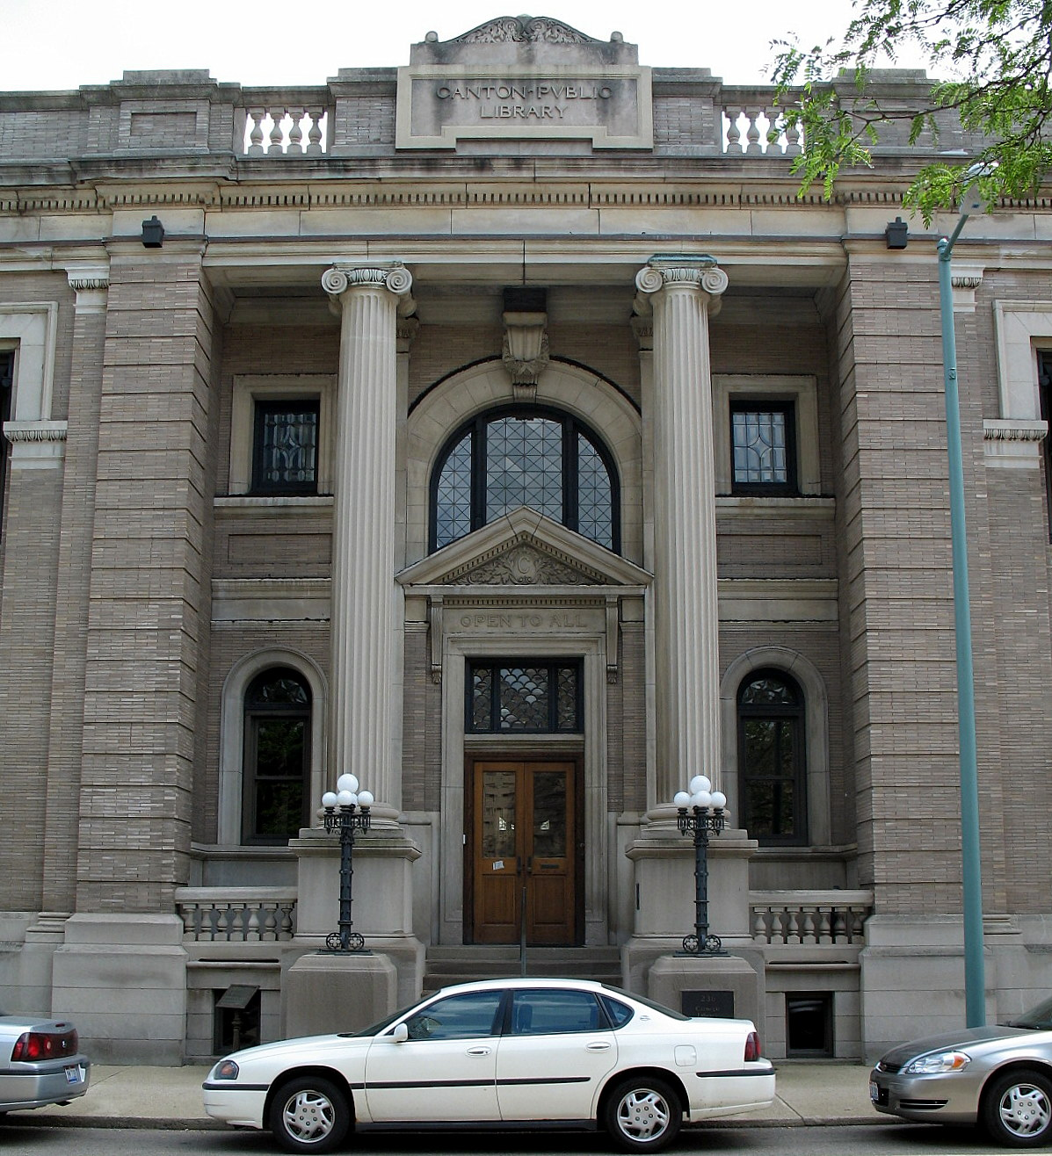
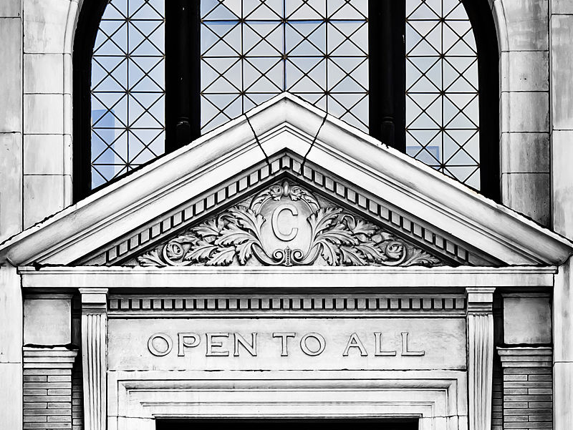
Notes:
Does anyone recognize this building? It’s the old Carnegie Library that was the original Canton Public Library by the City of Canton offices.
At the core of all public library service is the commitment that we are open to everyone and provide equal access to information. We are a public space – I like to think of us as the community living room, a hub, an anchor. We are one of the very few places where people can go without any expectation of spending any money or a required reason to be there.

Slide 5
We spark curiosity and foster knowledge
by connecting everyone to
resources, services, and opportunities.
Notes:
This is the primary work of our organization: We spark curiosity and foster knowledge by connecting everyone to resources, services, and opportunities.

Slide 6
To be a trusted guide in the community—
inviting, inspiring, and empowering all people
to pursue creativity and lifelong learning
Notes:
This is an aspirational statement – looking toward our future. We want to be a trusted guide in the community – inviting, inspiring, and empowering all people to pursue creativity and lifelong learning.

Slide 7
Notes:
Our values guide us in how we interact with each other, our patrons, and our partners. We live our values in the work that we do.

Slide 8
Notes:
We have several focus areas that we have been intentionally working on in response to community needs. They are tied to our values of Literacy, Respect, and Access.
DEI: We treat each individual with dignity, regardless of race, gender, faith, politics, or status. We want everyone to feel seen and reflected in the library – in our programs, collections, and policies.
School Readiness and Childhood Poverty: We promote reading, writing, and thinking at every season of life. This is especially important as students experienced tremendous learning loss due to the pandemic. And the City of Canton has the highest childhood poverty rate in the state.
Seniors: We help patrons tap into tools and resources, when they need them, from wherever they are. Stark County has an aging population, and we want to serve those in our community.

Slide 9
Job & Career Help
Notes:
It doesn’t matter if you’re just starting out on your career path or a seasoned professional, we have resources to help every step of the way— from navigating your online job search and creating a killer resume to preparing for your interview and keeping your skills current.
You can book an expert for one-on-one help, learn new skills through LinkedIn Learning, take practice tests including the ACT, SAT, PSAT, and GRE, do company research with Reference USA, and much more. We also offer many in-person technology classes at our branches for all skill levels.
We have computers with Microsoft Office, we offer many business services like free faxing, notary service, passports, and free printing up to 1.50 a day, meeting rooms, and study spaces.

Slide 10
Job Training Resources
https://starklibrary.org/home/services/job-and-career-training/
Notes:
Our website includes a variety of resources for job seekers such as yourself. The link to the specific page is listed here. On this site you can find a variety of databases and librarian-approved job resource sites. I encourage you to check this page out at your convenience. For this presentation, there are a few areas that I want to make sure to draw your attention to.

Slide 11
Job Training Resources
Book An Expert
Notes:
On the left side of this screen, you will see a list of specific topics you can search to find additional resources. All of this can be examined both at the library and from the comfort of your own couch! Here at the library, we have quite a few librarians and library workers who specialize in job resources and training. You can book an hour at a time with these experts to work on a variety of topics ranging from finding interesting jobs to apply for, working on your resume, and even practicing your interview skills. To book an expert, visit any Stark Library location, complete the request form (which is very short!), and then give it back to any staff member. The location manager will then work with staff to get you scheduled for your 1:1. This process takes less than a few days!

Slide 12
Researching Employers
Notes:
On our website you can find a number of sites that allow you to research potential employers. It is imperative before you apply and interview for a position that you make sure your values and goals match the organizations. As you know, an organization’s culture can make or break your work experience. These sites include information related to salary, values, and employee reviews. Looking at these sites will help you determine whether you’re are a good fit for the organizations, and what I argue is most important—whether the organization is a good fit for you.

Slide 13
Local and Specialized Job Listings
Notes:
Finding jobs can be very challenging. Our librarians have curated lists to help you find your next position. These sites are grouped into the following categories: general, local, public sector, and special interest job listings. The local job listings also includes information about apprenticeships. Starkjobs.com is one of my favorite sites for finding local opportunities. You can find anything from entry level representatives to management positions.

Slide 14
Professional Organizations
https://jobstars.com/professional-associations-organizations/
Notes:
While the sites we just discussed are helpful, if you are looking for professional or higher management positions, looking at your professional organization may be the best way to locate opportunities. Go to conferences if you can, try to get on the organization’s listserve is they have one, and network with as many people as you can. The American Library Association has a robust listing of job opportunities around the world, and it is always my first stop when looking at professional positions. If you aren’t sure what your professional organization is, I encourage you to check out the site listed here or simply google your field. An example would be “IT professional organization”. You may even get more specific. For example, “System Engineer Professional Organization”.

Slide 15
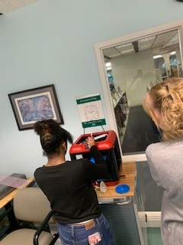
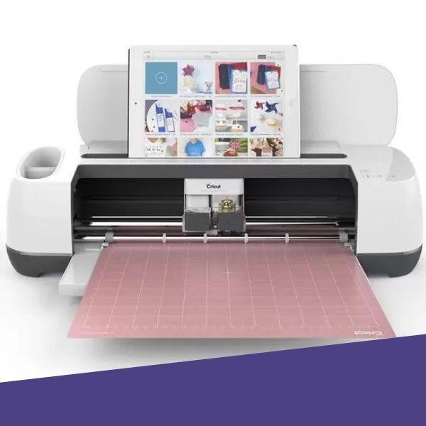
Maker Studio
Notes:
If you decide that you do not want to find a position with an established organization, you can always find resources here at the library to support your own business. Our MakerStudio at Main Library has all the tools you need to design and create. Many entrepreneurs use our equipment to further their business ideas.
We have many machines like badge/button makers, large format poster printer, heat press, sewing machines, embroidery machine, cricut, die cutting and embossing machine, 3d printer, video conversion machine, and photo preservation tools. The Library Foundation generously donated funds to purchase much of this equipment.
We offer open hours and free equipment classes throughout the week.

Slide 16
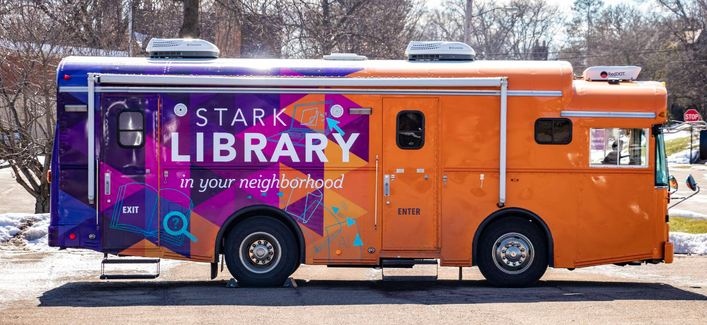
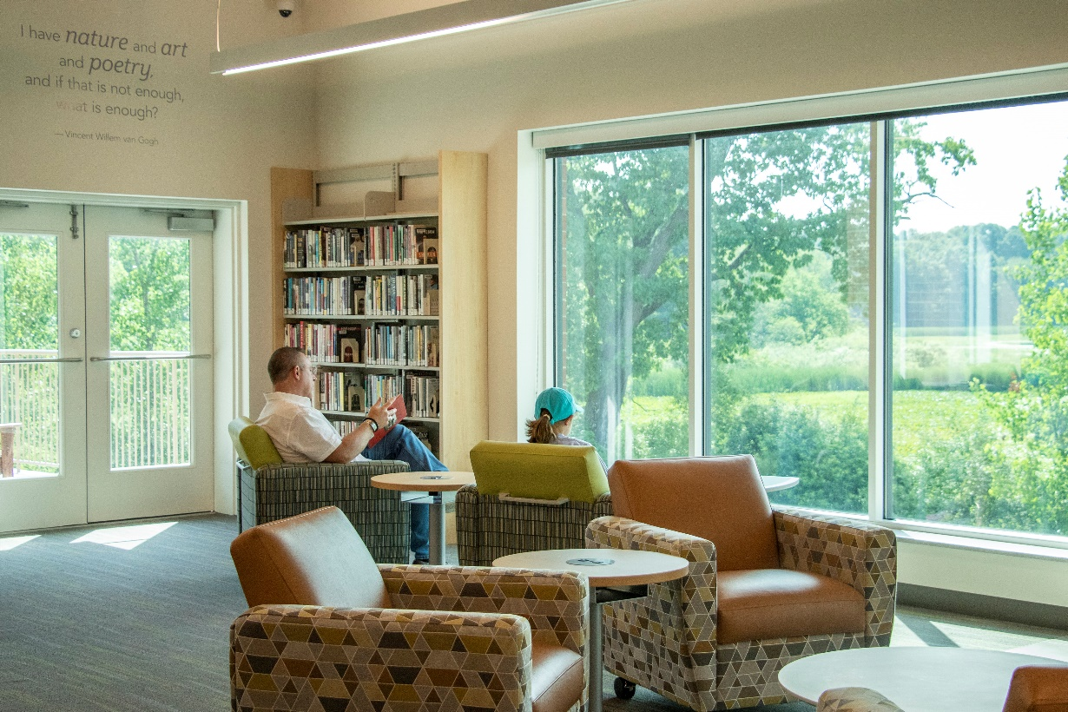
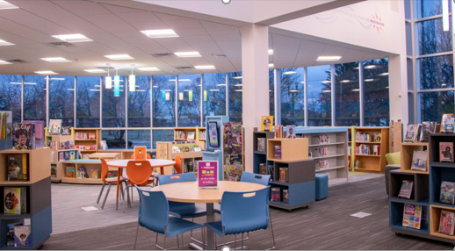
See you at the Library!
Notes:
I hope you learned something new about the services we offer at the library and that one of these services appeals to you.
I hope to see you soon at the library!
Thank you for your time. I’d be happy to answer any questions you might have.

